Slide 1

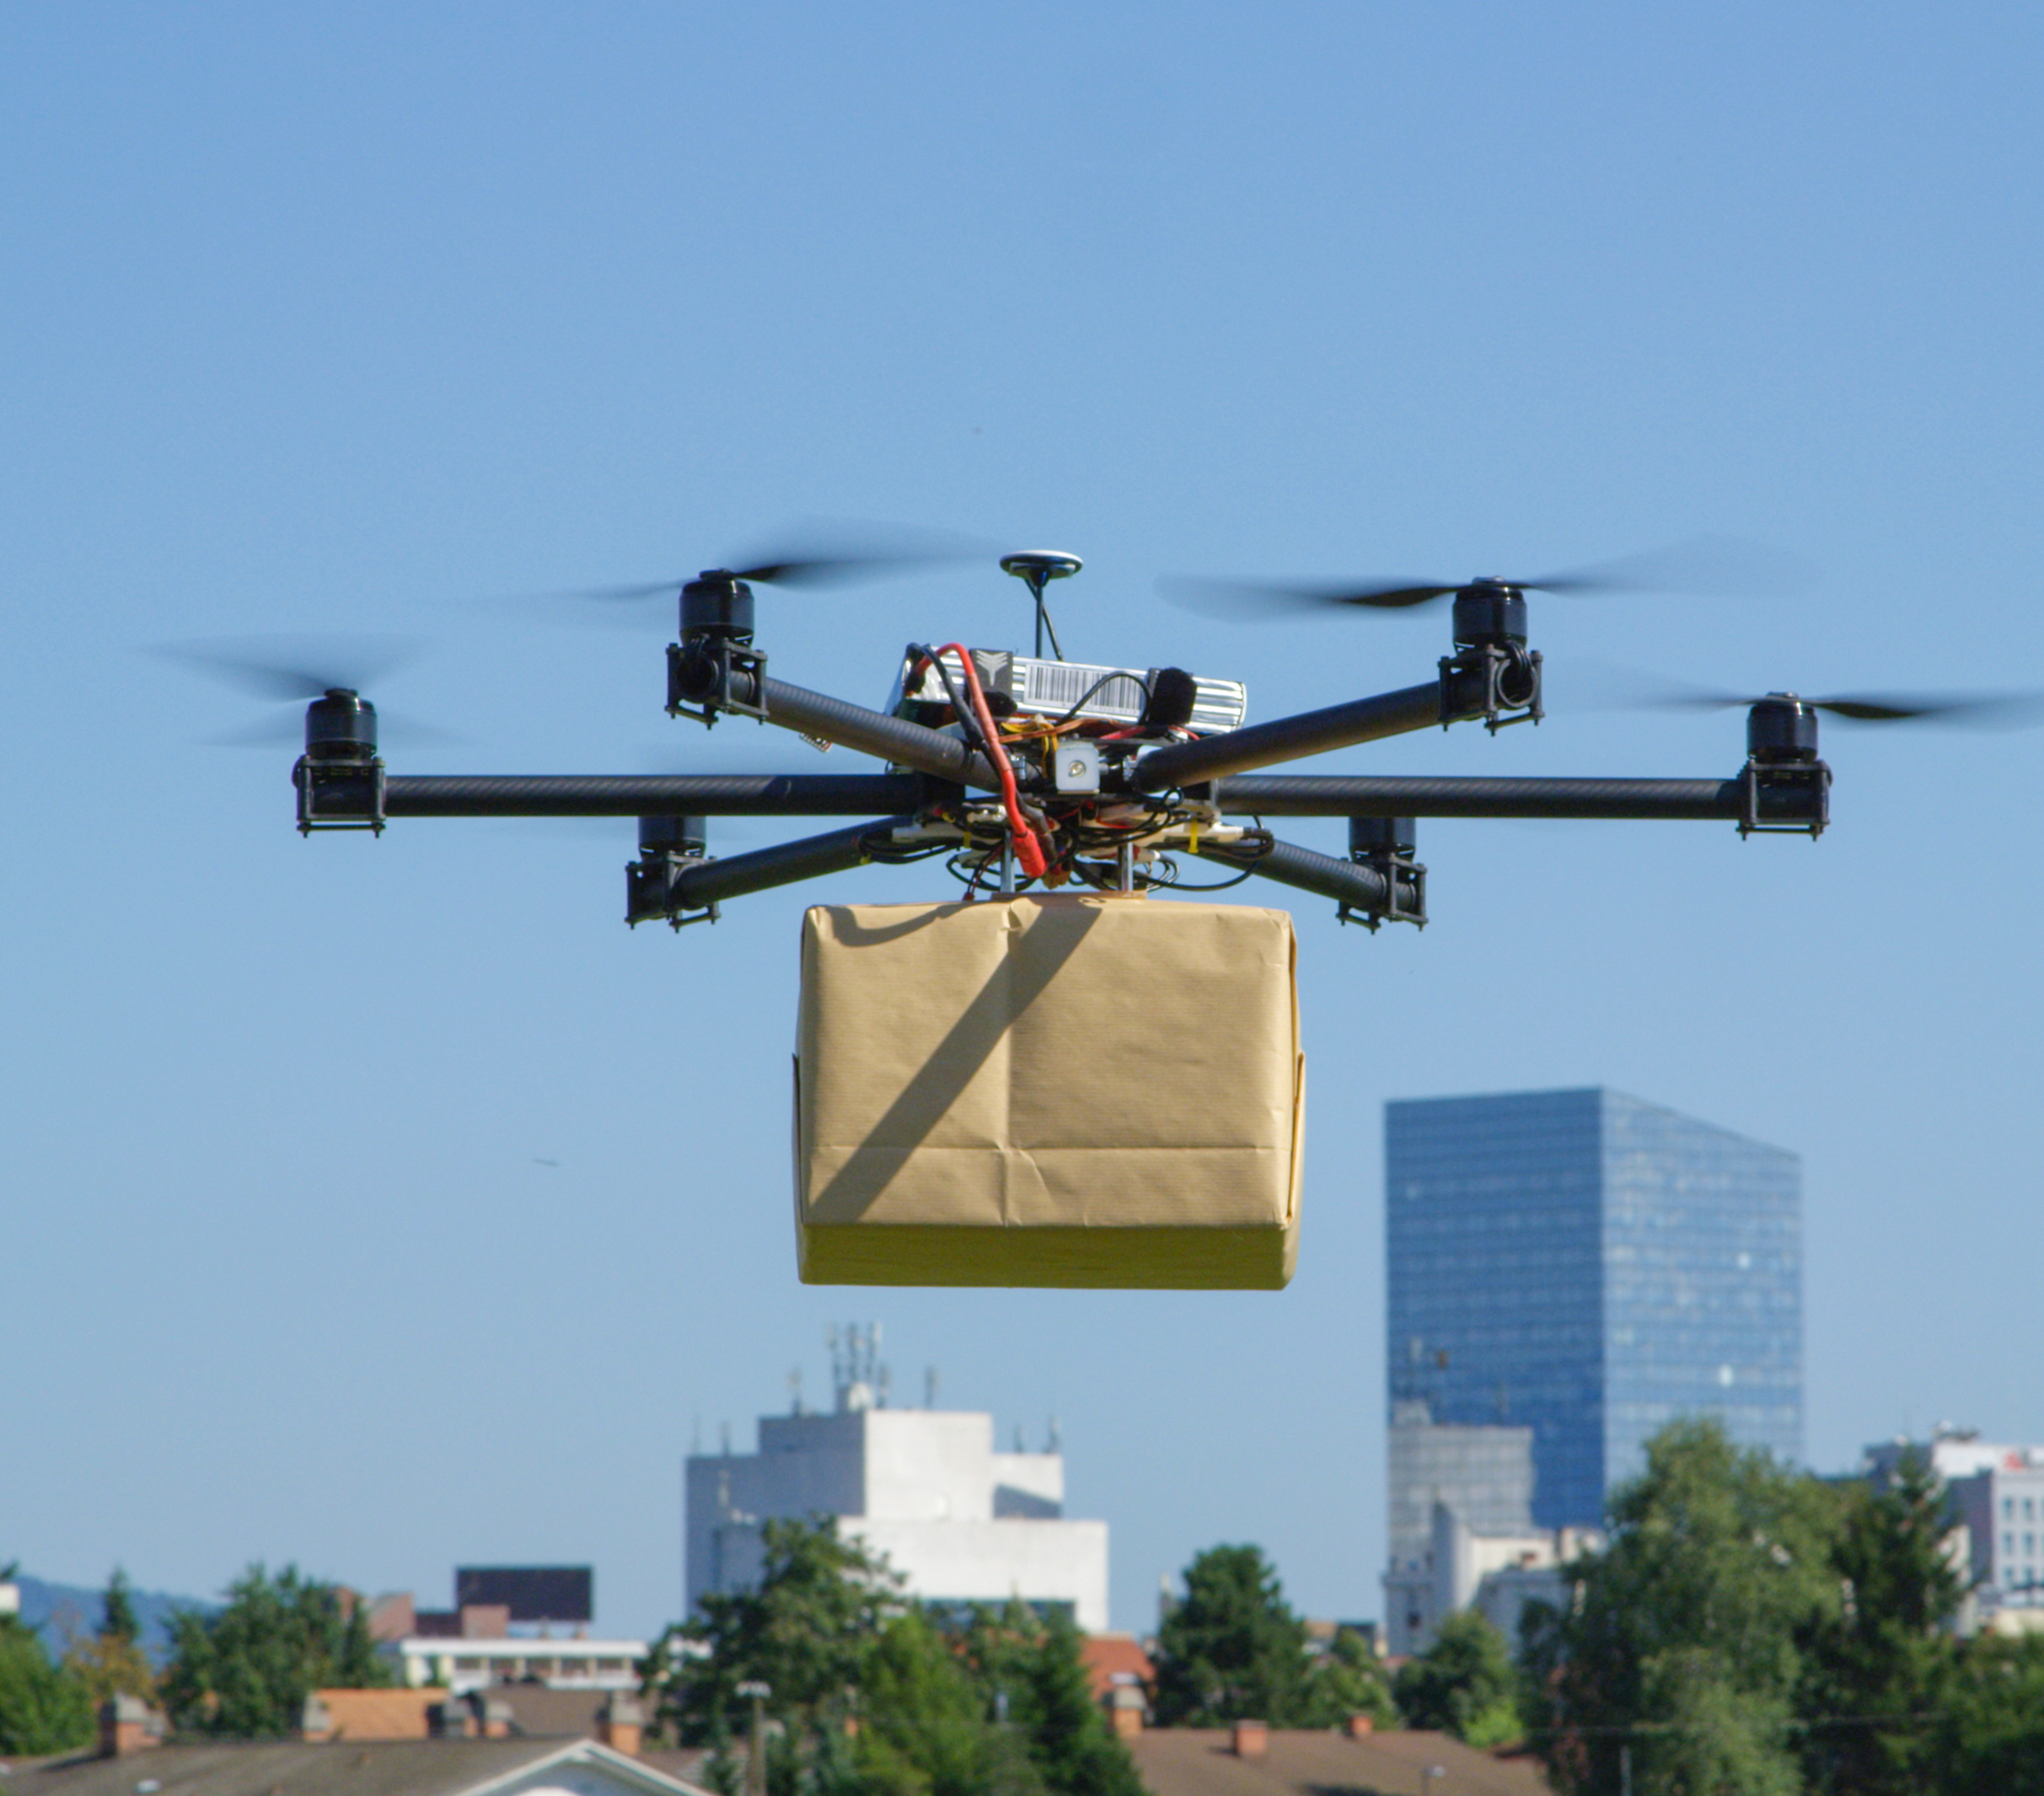
SESSION 7
Let’s
Improve

Slide 2
Guiding Questions
How can you sort the cargo more efficiently?
How can you create better access to the different destinations?
Outcomes
The team will design ways to improve access and efficiency.
The team will improve the efficiency of the sorting process.
How can you use a sensor to make the sorting center more efficient?
Can you improve how the sorting center works with a sensor?
Notes:
Each session has Guiding Questions that can be shared to frame the session.​
Session Tips
Give the team the LEGO® prototyping pieces (Bag 4) to create their designs.
Ask the team to identify places that would be hard to access in their community.
A machine operator will adjust settings on the control panel to ensure the machine is working efficiently.
Examples of efficiency include sorting cargo faster, sorting cargo by color, or stopping the sorting process when there is no cargo loaded.

Slide 3


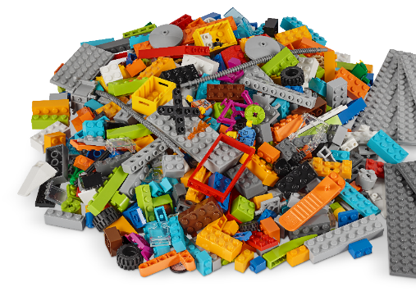
Introduction – Discovery Build
Examples of Discovery
Ask the students to provide examples of Discovery and record them here
Example of Discovery
Example of Discovery
We explored new skills and ideas.
Notes:
Introduction
Discovery Build
(10 minutes)
Have the team provide examples of how they have used discovery throughout the sessions.
Have the team create a build from the prototyping pieces representing this Core Value or examples of the team using discovery.

Slide 4


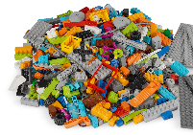

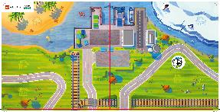

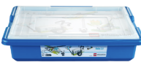

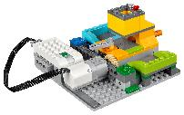
Task 1
Can you build
ways to improve
transportation
access or
efficiency?
You need…
Can
you build the
destinations where
cargo is being
delivered?
Notes:
Tasks (20 minutes)
Imagine how to answer Ruby and Jacob’s questions while looking at the mat. Dream big!
Using the prototyping pieces, build ways to improve access to the destinations (house icons on mat).
Show how you have improved access to each place for cargo deliveries.
Challenge
Create a new form of transportation that can access many different areas.

Slide 5

Task 1
Using the prototyping pieces, build ways to improve access to the destinations (house icons on mat).
Notes:
Tasks (20 minutes)
Imagine how to answer Ruby and Jacob’s questions while looking at the mat. Dream big!
Using the prototyping pieces, build ways to improve access to the destinations (house icons on mat).
Show how you have improved access to each place for cargo deliveries.
Challenge
Create a new form of transportation that can access many different areas.

Slide 6

Task 1
Show how you have improved access to each place for cargo deliveries.
Challenge
Create a new form of transportation that can access many different areas.
Notes:
Tasks (20 minutes)
Imagine how to answer Ruby and Jacob’s questions while looking at the mat. Dream big!
Using the prototyping pieces, build ways to improve access to the destinations (house icons on mat).
Show how you have improved access to each place for cargo deliveries.
Challenge
Create a new form of transportation that can access many different areas.

Slide 7
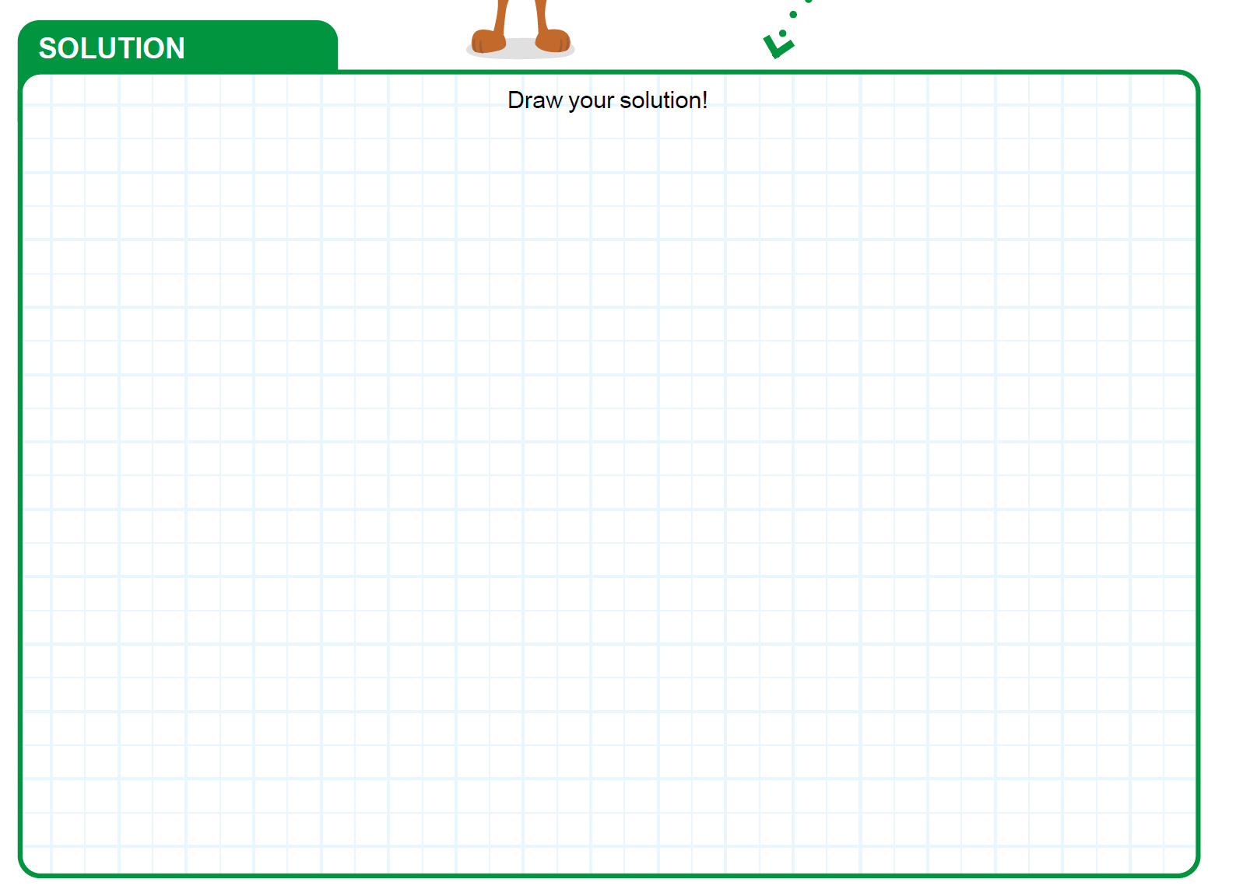
Task 2
Launch the WeDo 2.0 app.
Can you use a sensor to improve the efficiency of the sorting process? Dream up your solution.
Notes:
Tasks (20 minutes)
Launch the WeDo 2.0 app.
Can you use a sensor to improve the efficiency of the sorting process? Dream up your solution.
Alter the sorting center to include a sensor.
Create a new program and try it out on the sorting center.
Challenge
Can you add a different sensor to improve the sorting process?

Slide 8

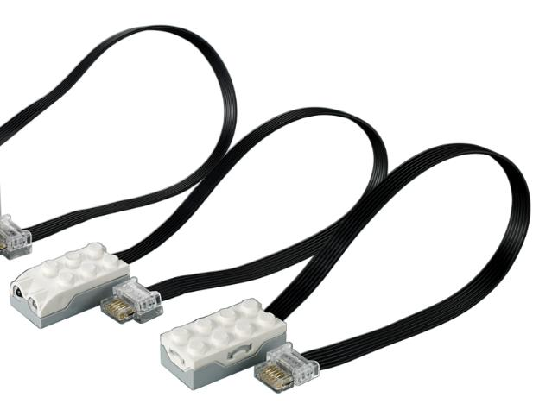
Task 2
Alter the sorting center to include a sensor.
Create a new program and try it out on the sorting center.
Challenge
Can you add a different sensor to improve the sorting process?
Notes:
Tasks (20 minutes)
Launch the WeDo 2.0 app.
Can you use a sensor to improve the efficiency of the sorting process? Dream up your solution.
Alter the sorting center to include a sensor.
Create a new program and try it out on the sorting center.
Challenge
Can you add a different sensor to improve the sorting process?

Slide 9

Share
Why would a
machine operator make
adjustments to the
sorting center? Discuss
as a team!
Share what you did in the session.
Show the destinations you create for cargo deliveries.
Demonstrate how you improved access to destinations.
Explain how you improved sorting efficiency.
Notes:
Share (10 minutes)
Have the team:
Share what they did in the session.
Show the destinations they created for cargo deliveries.
Demonstrate how they improved access to destinations.
Explain how they improved sorting efficiency.

Slide 10

Optional Video:
You may wish to embed a relevant, age-appropriate video for your students here. See the Notes for an example.
Notes:
Choose a relevant, age-appropriate video for your students.
Here is one example: Ford’s Delivery Robot Walks On Two Legs Like A Human from Tech Insider - https://youtu.be/U8Iey_wfo0I
Search for “delivery robots” to find other videos about innovative delivery solutions.

Slide 11
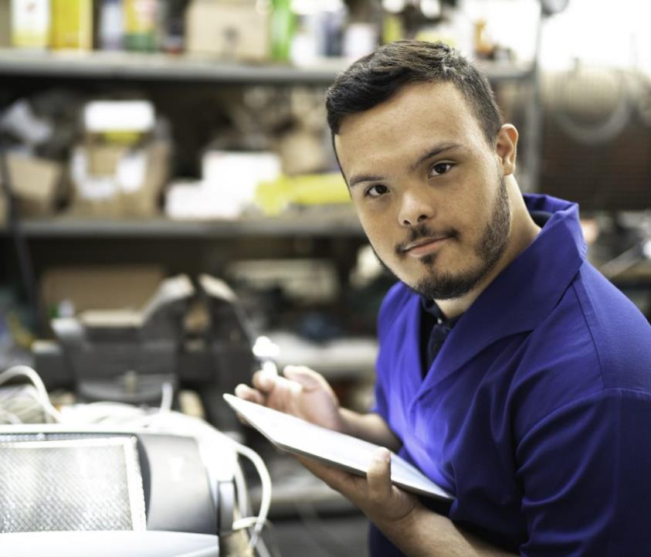
Career Connections
Machine Operator
Role:
Monitors and maintains warehouse sorting machines.
Notes:
Discuss the meanings of “monitor” and “maintain.” What parts of sorting machines would they like to work on as a machine operator?

Slide 12

Clean Up
Notes:
You may wish to play a video or song during clean up time Link on GoNoodle: https://family.gonoodle.com/activities/clean-up. Link on YouTube Kids: https://www.youtubekids.com/watch?v=ZJFk87ZsHn0 . Link on Youtube: https://youtu.be/ZJFk87ZsHn0
Cleanup Pointers
The motorized sorting center should stay assembled, but everything else should be taken apart.
Check that any pieces used from the LEGO® set are returned to it.

Slide 13
FIRST® and the FIRST® logo are registered trademarks of For Inspiration and Recognition of Science and Technology (FIRST). LEGO® is a registered trademark of the LEGO Group. FIRST® LEGO® League and CARGO CONNECTSM are jointly held trademarks of FIRST and the LEGO Group. All other trademarks are the property of their respective owners. ©2021 FIRST and the LEGO Group. All rights reserved.

